Slide 1
COMP 3500 Introduction to Operating Systems Synchronization: Part 4 Classical Synchronization Problems
Dr. Xiao Qin
Auburn University http://www.eng.auburn.edu/~xqin
xqin@auburn.edu
Notes:
50 Minutes: Slides 1-8

Slide 2
Recap: Mutex Locks
Solve critical section problems using OS
Mutex lock: protect a critical section
acquire() a lock
release() the lock
acquire() and release() must be atomic
This solution requires busy waiting
Notes:
Previous solutions are complicated and generally inaccessible to application programmers
OS designers build software tools to solve critical section problem
Simplest is mutex lock
Protect a critical section by first acquire() a lock then release() the lock
Boolean variable indicating if lock is available or not
Calls to acquire() and release() must be atomic
Usually implemented via hardware atomic instructions
But this solution requires busy waiting
This lock therefore called a spinlock

Slide 3
Recap: Semaphore Implementation
typedef struct {
int value; struct process *L; } semaphore;
wait(semaphore *S) {
S->value--;
if (S->value < 0) { add this process to S->list;
block();
}
}
signal(semaphore *S) {
S->value++;
if (S->value <= 0) { remove a process P from S->list;
wakeup(P);
}
}

Slide 4
Deadlock and Starvation
Deadlock – two or more processes are waiting indefinitely
Let S and Q be two semaphores initialized to 1
P₀ P₁
wait(S); wait(Q);
wait(Q); wait(S);
... ...
signal(S); signal(Q);
signal(Q); signal(S);
Starvation – indefinite blocking
A process never be removed from the semaphore queue
Notes:
Deadlock – two or more processes are waiting indefinitely for an event that can be caused by only one of the waiting processes
Let S and Q be two semaphores initialized to 1
P₀ P₁
wait(S); wait(Q);
wait(Q); wait(S);
... ...
signal(S); signal(Q);
signal(Q); signal(S);
Starvation – indefinite blocking
A process may never be removed from the semaphore queue in which it is suspended
Priority Inversion – Scheduling problem when lower-priority process holds a lock needed by higher-priority process
Solved via priority-inheritance protocol

Slide 5
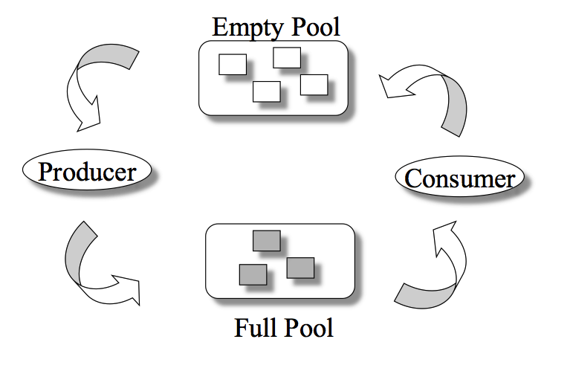
The Bounded-Buffer Problem
n buffers, each can hold one item
Q1: What semaphores do you need to control the shared pool?
Semaphore mutex: initial value 1
Semaphore full: initial value 0
Semaphore empty initial value n
Notes:
Classical Problems of Synchronization
Classical problems used to test newly-proposed synchronization schemes
Bounded-Buffer Problem
Readers and Writers Problem
Dining-Philosophers Problem
Semaphore mutex initialized to the value 1
Semaphore full initialized to the value 0
Semaphore empty initialized to the value n

Slide 6
The Producer Process
do {
... /* produce an item in next_produced */
...
wait(empty);
wait(mutex);
... /* add next produced to the buffer */
...
signal(mutex);
signal(full);
} while (true);
Q2: Where to place the mutex semaphore?

Slide 7
Q3: Can you design the consumer process?
Do {
wait(full);
wait(mutex);
... /* remove an item from buffer to
next_consumed */
...
signal(mutex);
signal(empty);
... /* consume the item in next consumed */
... } while (true);

Slide 8
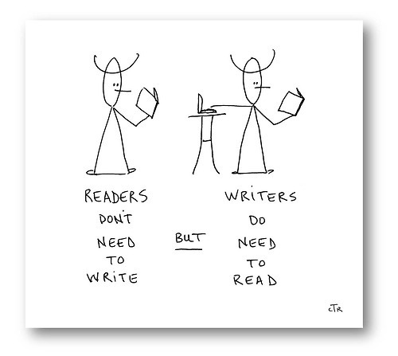
The Readers-Writers Problem
Concurrent processes
Readers – only read data; do not perform updates
Writers – both read and write
Problem:
Allow multiple readers to read at the same time
Only one single writer can access the shared data
Q4: What semaphores do we need?
Semaphore rw_mutex initialized to 1
Semaphore mutex initialized to 1
Integer read_count initialized to 0
Notes:
A data set is shared among a number of concurrent processes
Readers – only read the data set; they do not perform any updates
Writers – can both read and write
Problem – allow multiple readers to read at the same time
Only one single writer can access the shared data at the same time
Several variations of how readers and writers are considered – all involve some form of priorities
Shared Data
Data set
Semaphore rw_mutex initialized to 1
Semaphore mutex initialized to 1
Integer read_count initialized to 0

Slide 9
The Writer Process Q4: Which semaphore should we use here?
Q5: Is it a semaphore or lock?
do { wait(rw_mutex);
... /* writing is performed */
...
signal(rw_mutex);
} while (true);
Only one single writer can access the shared data

Slide 10
The Reader Process Q6: Can you explain the following process?
do { wait(mutex); read_count++; if (read_count == 1)
wait(rw_mutex);
signal(mutex);
... /* reading is performed */
...
wait(mutex); read count--; if (read_count == 0)
signal(rw_mutex);
signal(mutex);
} while (true);
A writer is in the critical section, n readers are waiting. Then …
n-1 wait here
1st waits here
Critical section?
Let a writer access
Multiple readers can access the shared data

Slide 11
Other Readers-Writers Problems
Problem 1: no reader kept waiting unless writer has permission to use shared object
Problem 2: once writer is ready, it performs the write ASAP
Both may have starvation
Notes:
Problem is solved on some systems by kernel providing reader-writer locks

Slide 12
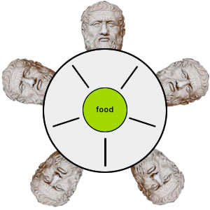
The Dining-Philosophers Problem
Philosophers spend their lives thinking and eating
Occasionally try to pick up 2 chopsticks (one at a time) to eat from bowl
In the case of 5 philosophers: Shared data
Bowl of rice
Semaphore chopstick [5] initialized to 1
Notes:
Philosophers spend their lives alternating thinking and eating
Don’t interact with their neighbors, occasionally try to pick up 2 chopsticks (one at a time) to eat from bowl
Need both to eat, then release both when done
In the case of 5 philosophers
Shared data
Bowl of rice (data set)
Semaphore chopstick [5] initialized to 1

Slide 13
The structure of Philosopher i
do {
wait (chopstick[i] );
wait (chopStick[ (i + 1) % 5] );
// eat
signal (chopstick[i] );
signal (chopstick[ (i + 1) % 5] );
// think
} while (TRUE);
Q7: What is the problem with this algorithm?

Slide 14
Deadlock Handling
Allow at most 4 philosophers to be sitting simultaneously at the table.
Allow a philosopher to pick up the forks only if both are available (picking must be done in a critical section.
Use an asymmetric solution -- an odd-numbered philosopher picks up first the left chopstick and then the right chopstick. Even-numbered philosopher picks up first the right chopstick and then the left chopstick.
Notes:
Allow at most 4 philosophers to be sitting simultaneously at the table.
Allow a philosopher to pick up the forks only if both are available (picking must be done in a critical section.
Use an asymmetric solution -- an odd-numbered philosopher picks up first the left chopstick and then the right chopstick. Even-numbered philosopher picks up first the right chopstick and then the left chopstick.

Slide 15
Problems with Semaphores
Incorrect use of semaphore operations:
signal (mutex) …. wait (mutex)
wait (mutex) … wait (mutex)
Omitting of wait (mutex) or signal (mutex) (or both)
Deadlock and starvation are possible.

Slide 16
Monitors
A high-level abstraction for process synchronization
Abstract data type: internal variables only accessible by code within the procedure
Only one process may be active within the monitor at a time
But not powerful enough to model some synchronization schemes
monitor monitor-name
{
// shared variable declarations
procedure P1 (…) { …. }
procedure Pn (…) {……}
Initialization code (…) { … }
}
Notes:
A high-level abstraction that provides a convenient and effective mechanism for process synchronization
Abstract data type, internal variables only accessible by code within the procedure
Only one process may be active within the monitor at a time
But not powerful enough to model some synchronization schemes

Slide 17
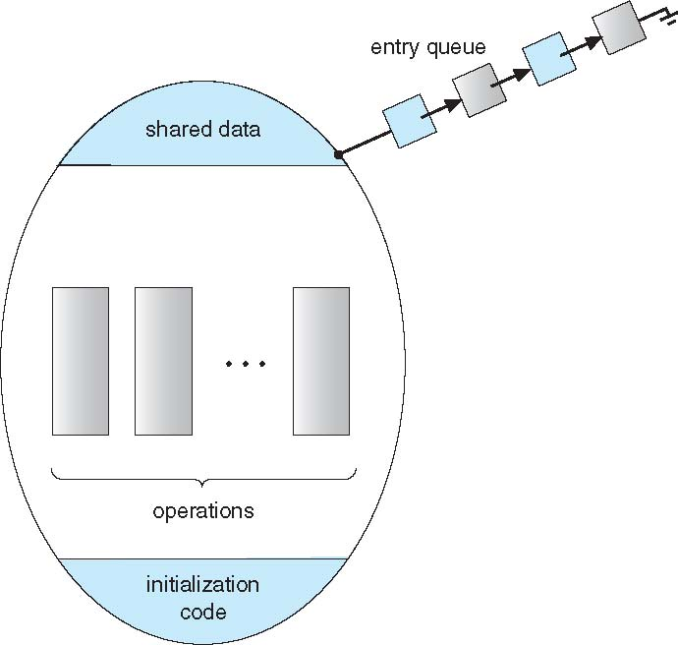
A Monitor

Slide 18
Summary
The Bounded-Buffer Problem
The Readers-Writers Problem
The Dining-Philosophers Problem
Introduction to Monitors
Notes:
Summary of Chapter 5.

